Slide 1
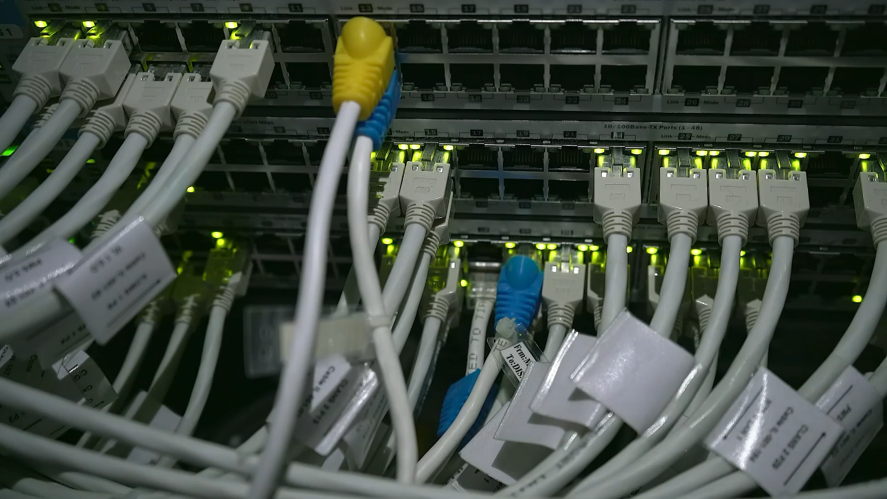
Network Architecture

Slide 2
Network Hub
Hub
L2
1 broadcast domain
1 collision domain

Slide 3
Network Switch
Switch
L2
1 broadcast domain
Multiple collision domains (1 collision domain per port)

Slide 4
Network Router
Router
L3
L2 Switch
L2
1 broadcast domain
Multiple collision domains (1 collision domain per port)

Slide 5
Daisy-Chaining
Router
L2 Switch
L2
1 broadcast domain
Multiple collision domains (1 collision domain per port)

Slide 6
2-Tier Architecture
Router
Multilayer switch L2/3/4 switch
Distribution/Aggregation
Spanning Tree Protocol (STP)
Access

Slide 7
VLAN Switching
L3 Router
L2 Switch
L2+L3 Switch
VLAN 1
VLAN 2
VLAN 1
VLAN 2

Slide 8
3-Tier (3-Layered) Architecture
Internet
Core
L3
Distribution/Aggregation
L2
Virtual-port-channel (vPC) or Spanning Tree Protocol (STP)
Access (Top-of-Rack ToR)
End devices
Pod

Slide 9
3-Tier (3-Layered) Architecture
Internet
Core
L2/L3
Distribution/Aggregation
Virtual-port-channel (vPC)
Access
North-South Traffic
End devices
Pod

Slide 10
Spine-Leaf Architecture
Internet
Spine
L3
Leaf
L2
End devices
East-West Traffic

Slide 11
Demiliterized Zone (DMZ)
Firewall
Internet
DMZ

